Slide 1
DATABASE AND APPLICATION ARCHITECTURE

Slide 2
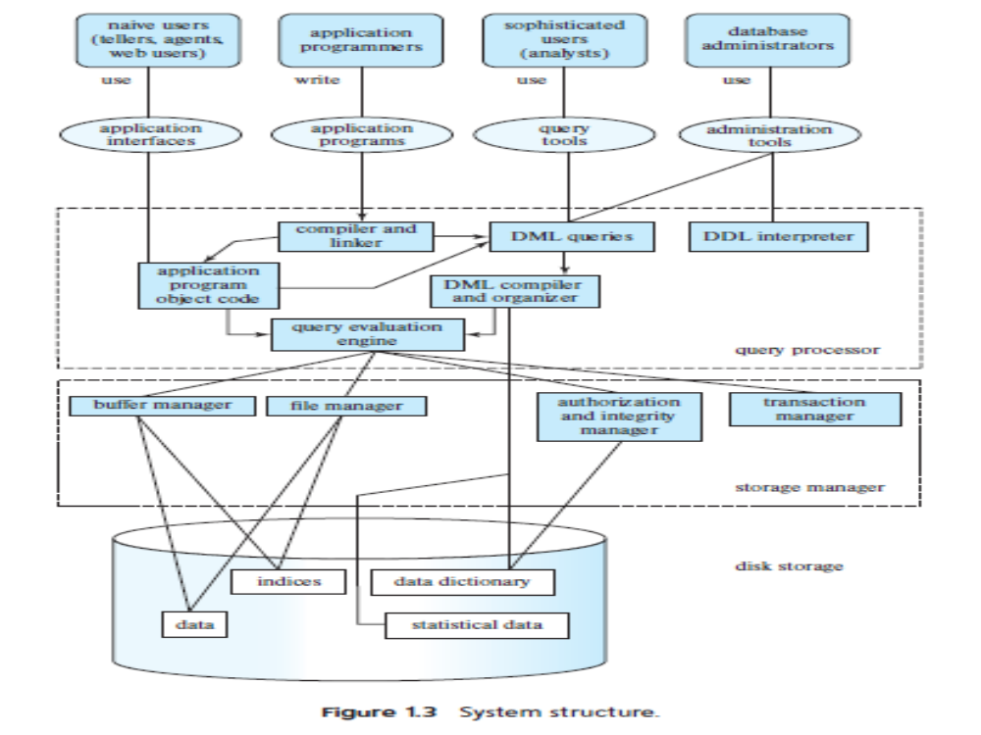

Slide 3
It summarizes
how different types of users interact with a database
how the different components of a database engine are connected to each other.
The centralized architecture is applicable to shared-memory server architectures, which have multiple CPUs and exploit parallel processing, but all the CPUs access a common shared memory.

Slide 4
To scale up to even larger data volumes and even higher processing speeds, parallel databases are designed to run on a cluster consisting of multiple machines.
Distributed databases allow data storage and query processing across multiple geographically separated machines.

Slide 5
Database applications can be partitioned into two or three parts
  two-tier architecture
  three-tier architecture
In two-tier architecture, the application resides at the client machine, and invokes database system functionality at the server machine through query language statements.

Slide 6
Modern database applications use a three-tier architecture, where the client machine acts as front end and does not contain any direct database calls.
Web browsers and mobile applications are the most commonly used application clients today.
The front end communicates with an application server.
The application server communicates with a database system to access data.

Slide 7
The business logic of the application says what actions to carry out under what conditions, is embedded in the application server, instead of being distributed across multiple clients.
Three tier applications provide better security as well as better performance than two-tier applications.

Slide 8
